Slide 1
Persistent Solar Powered Airplanes: Closing the Energy Cycle
Dr. Kevin R. Uleck
11 February 2020
Uleck.kevin@aurora.aero

Slide 2
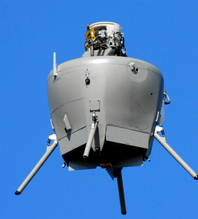
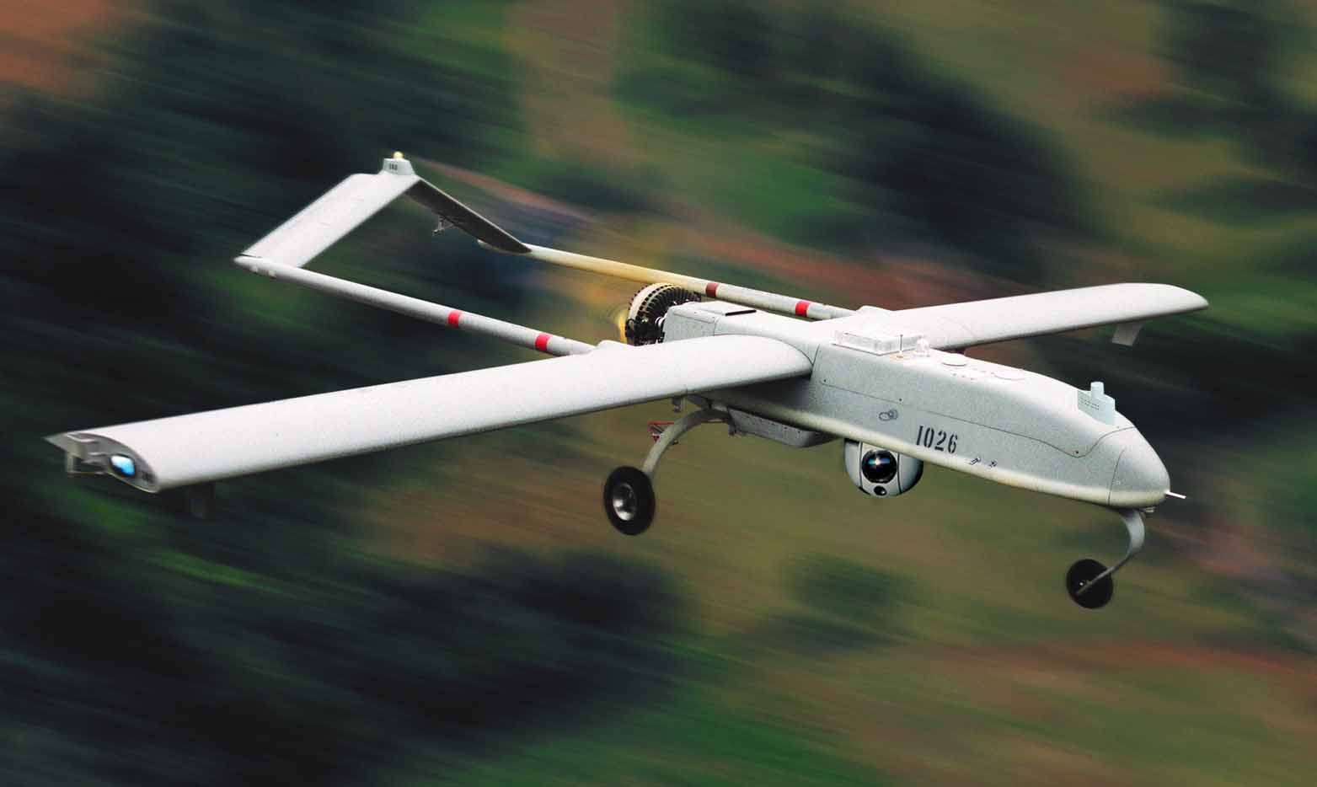
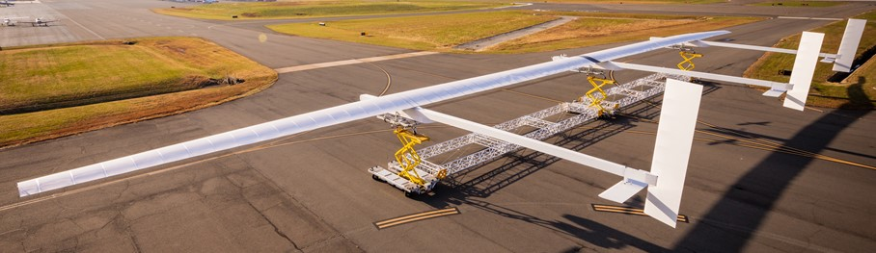
Kevin R. Uleck, PhD Program Manager, Odysseus Solar UAV, Aurora Flight Sciences
UAV Experience:
Concept Study through Program of Record
Aurora Flight Sciences (Since 2002)
Perseus-B
CUAV / GoldenEye-100
GoldenEye-50
OAV-II / GoldenEye-80
Excalibur
Vulture:
RapidEye
High altitude airship (LM sub)
Solar UAV (PM, present)
Raytheon
KillerBee
AAI / Textron
Shadow 200 (RQ-7B)
Shadow M2
Aerosonde
Education:
BS, MS, PhD @ U. Maryland
Composite structures
Aerodynamics, helicopters
UAV lab co-founder
Outside the office:
Musician – lots of performing
Runner, cyclist
Dad to 3 great kids!

Slide 3


Solar Airplane Energy Challenge: Closing The Energy Cycle
≥ Energy Required
Flight Energy = Power * Time = Thrust*Velocity * 24 hours
Energy storage: needed to last though the night
Flight Speed > wind speed
Thrust = Weight/(L/D)
Energy In
Solar flux in space
Atmospheric absorption
Shape / Collection factor
Length of day vs DOY, latitude
Solar panel efficiency

Slide 4
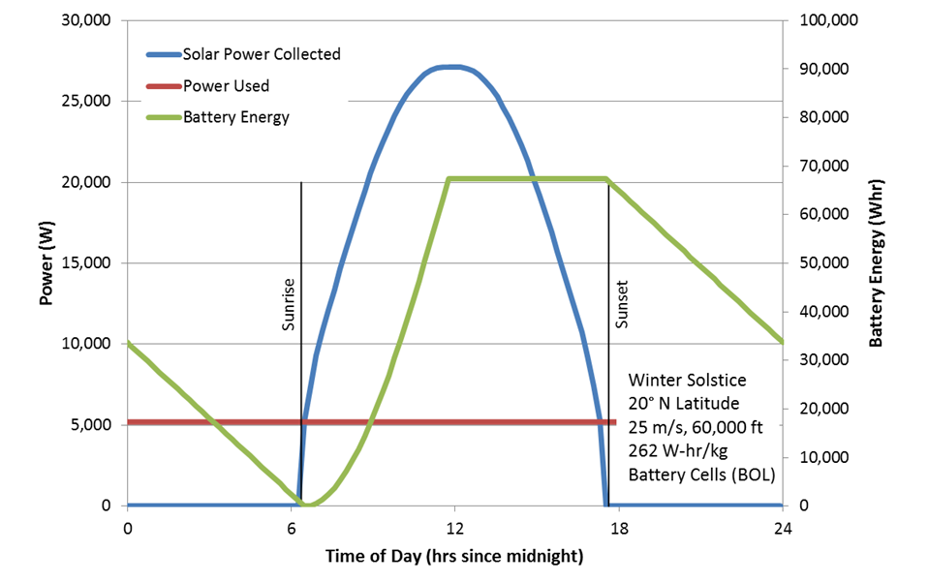
Closing The Energy Cycle
Two Conditions must be met:
Energy In ≥ Energy Used over 24 hour cycle
Battery Energy ≥ Energy Required for “Night”
Two primary solar power flows:
Daytime flight power
Energy storage for nighttime flight

Slide 5
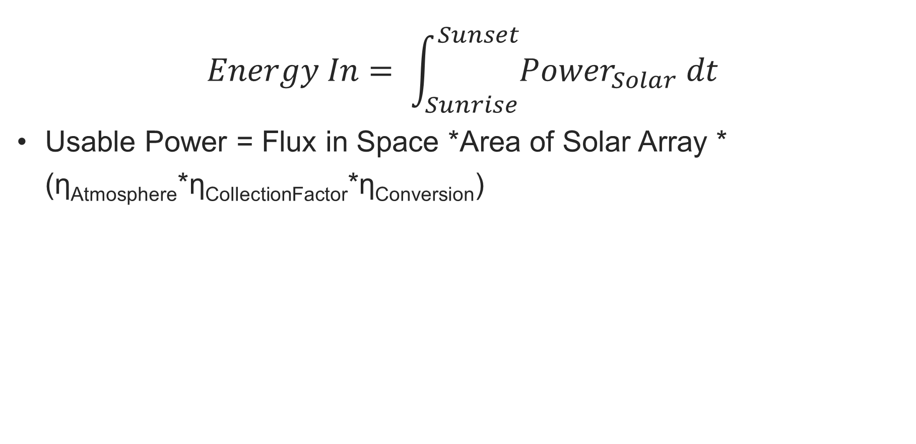
Energy In: Solar Power Available
$$Energy In= \int_{Sunrise}^{Sunset}{{Power}_{Solar} dt}$$
Usable Power = Flux in Space *Area of Solar Array * (η_{Atmosphere}*η_{CollectionFactor}*η_{Conversion})
Solar flux in space ~ 1367 W/m^{2 (standard nominal value)}
$$P_{out}= Φ_{Local}∗\cos\left(θ\right)∗ η_{Scatter}∗η_{Solar net}$$

Slide 6
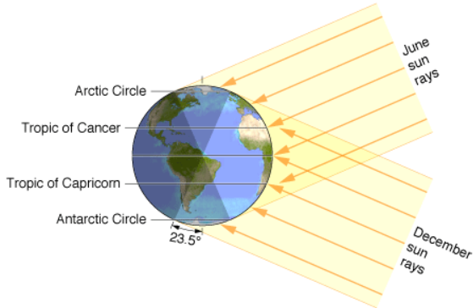
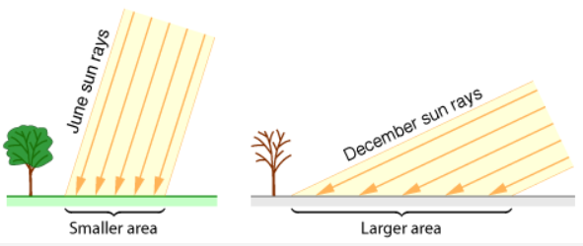
Energy In: Latitude & Length of Day
Hours of sunlight function of day of year, latitude, altitude
Hours of Darkness drives how much battery is required
Notes:
In winter months (autumnal equinox to vernal equinox), flying south increases daylight. However, in summer months (vernal equinox to autumnal equinox), moving North increases daylight. A key takeaway is that airplane must be able to fly at least 11 hours on battery else it is a summer only airplane and might not even be able to cover equatorial regions!

Slide 7
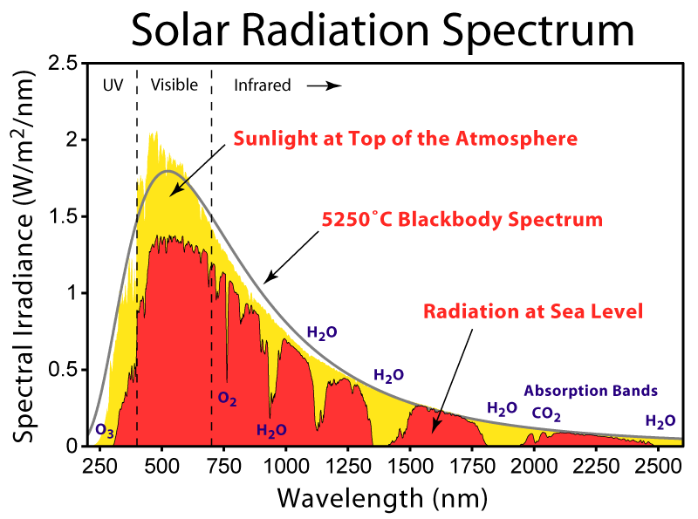
Energy In: Solar Power Available- Atmospheric Absorption
Solar flux absorbed by atmosphere
Absorption depends on mass and composition of air through which sunlight travels
Common reference conditions referred to as AM1.5 (sea level standard) and AM0 (space)
Flux available f(altitude, solar angle)
Spectral content also changes as light is filtered through atmosphere – impacts solar cell efficiency
Solar cell efficiency typically reported for AM1.5 conditions
Notes:
Check Alta cell spectral efficiency

Slide 8
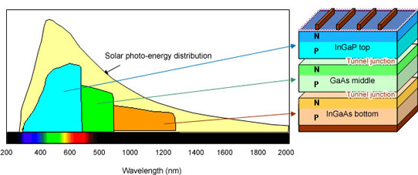
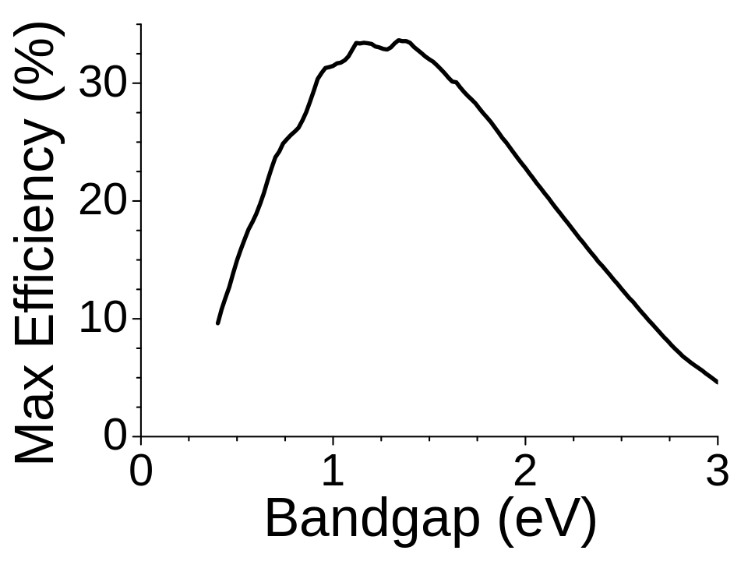
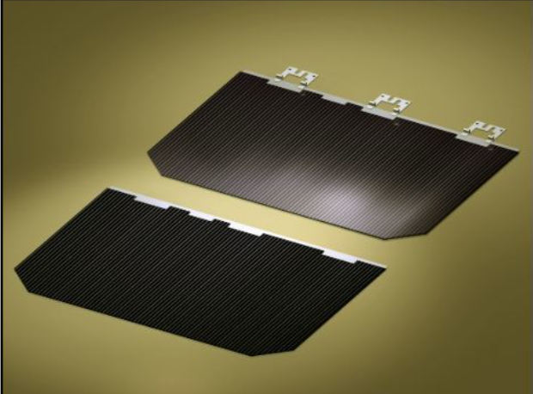
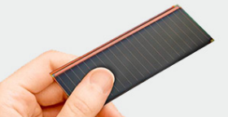
Energy In: Solar-Electric Conversion Efficiency
Solar cell spectral efficiency determined by junction materials, packaging, number of junctions
Single junction installed η_{max}≈24% for GaAs or Si
Multiple junction cells use larger bandwidth of available solar flux to achieve higher efficiency
Maximum efficiency of single junction cell limited to ~34% (the Shockley-Queisser limit)
Alta GaAs cell
Spectrolab 3J cell

Slide 9
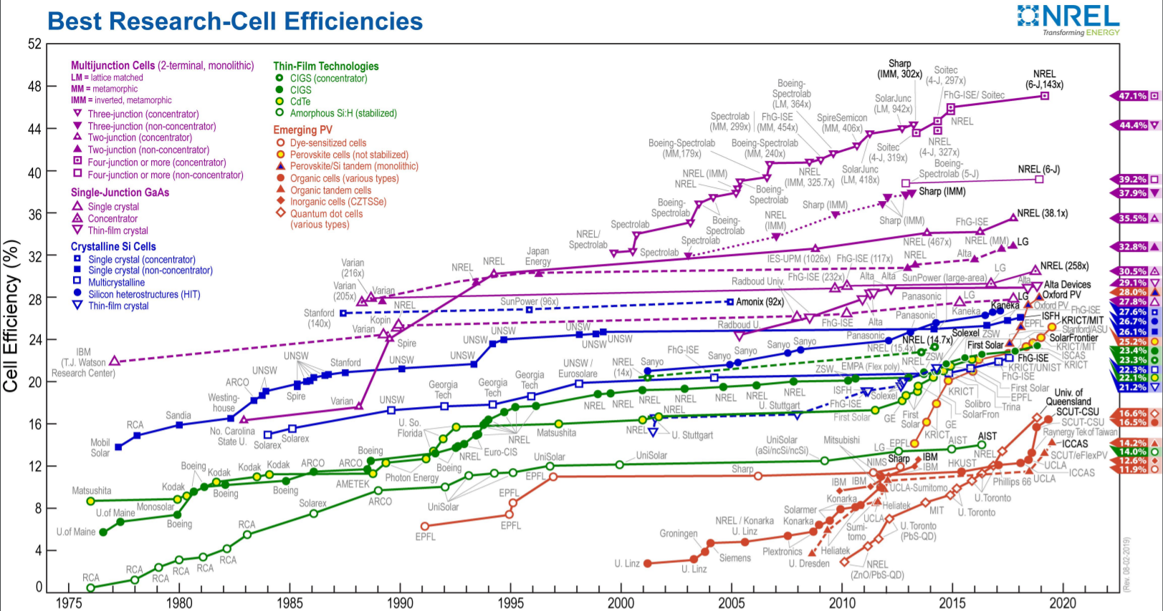
What we are using

Slide 10
From cell efficiency to useable power
Final installed solar conversion efficiency is affected by many factors

Slide 11
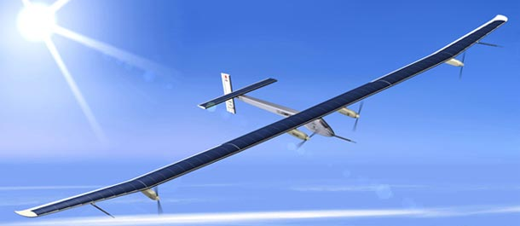
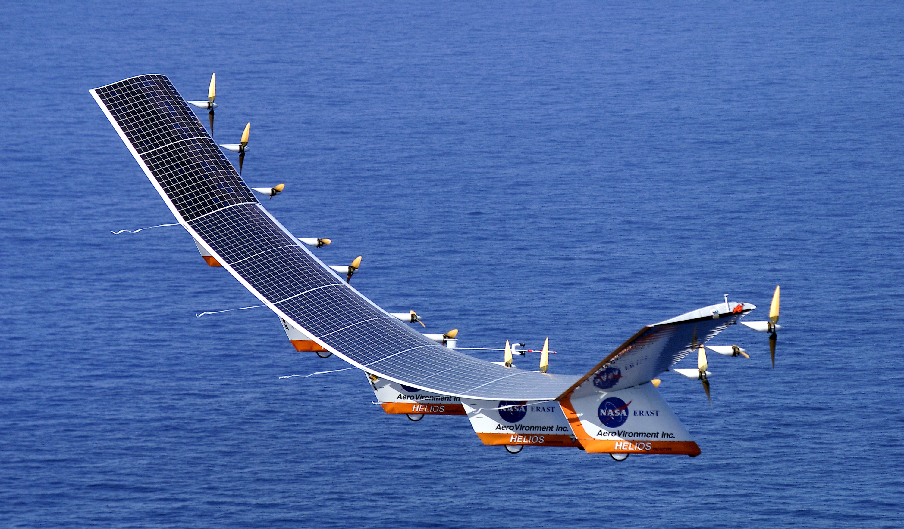
Energy In: Solar Panel Area
Power collected is proportional to solar array size, more array = more energy!?
Factors to consider for aircraft application of solar array
Power/Weight: different solar cell technologies offer range of weight / area for different price, efficiency, and durability
Area available: wings and surfaces might need to be increased beyond aerodynamically required size
Orientation: Aerodynamically shaped surfaces offer different compromises to sun tracking → collection factor
Flexibility → Durability and formability
SolarImpulse
Helios

Slide 12
Energy In: Incident Flux Collection Factor
Angle between sun vector and solar panel surface normal determines incident power (cosine losses)
Sun vector normal to panel → 100% power
Sun vector parallel to panel → 0% power
Additional losses at low solar incidence angles due to surface reflection
Angle depends on sun elevation, and aircraft attitude
Changes throughout the day and with vehicle heading

Slide 13
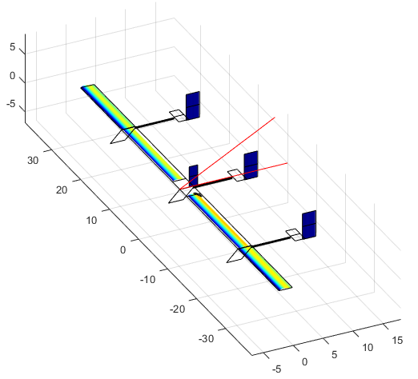
Energy In: Collection Factor (2)
Aircraft geometry affects relative solar incidence angle, and surface shadowing
Notes:
Look at variation of solar power over wing chord!

Slide 14
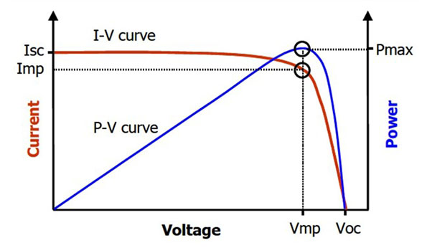
Energy In: Solar Cell Power Point Tracking
Solar cell can be operated at any voltage from full short up to junction voltage (V_{OC})
Power output is product of current * voltage
Circuit voltage regulation required to operate solar cell at peak power point to obtain maximum output
Typically achieved through Maximum Peak Power Point trackers, essentially DC-DC converters setting circuit voltage
Achieving maximum efficiency requires dynamic matching of load to solar array output

Slide 15
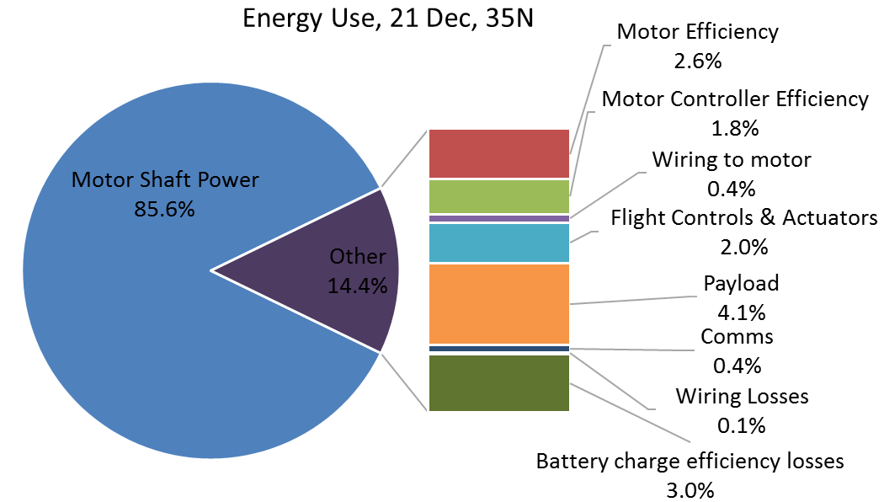
Energy Required: Daily Energy Breakdown
Question to answer: How much energy is needed to fly for 24 hours?
Majority of energy goes to propulsion
Propulsion Energy = Power * Time = Thrust*Velocity * 24 hours

Slide 16
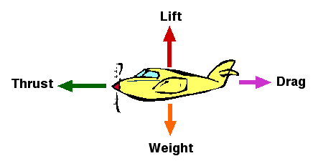
Propulsion Power Required = Thrust X Airspeed
For steady level flight, Thrust = Drag
Drag = Weight/(L/D)
L/D = Lift-to-Drag ratio, measure of aerodynamic efficiency.
Determined by aerodynamic profile and operating condition
Minimum power airspeed
Drag is proportional to Weight
Drag is proportional to Airspeed²
Thrust Power = Thrust * Airspeed
Power required is proportional to airspeed cubed
To minimize power required, fly slow!
Op Point
Odysseus cruises on 6.5 hp!

Slide 17
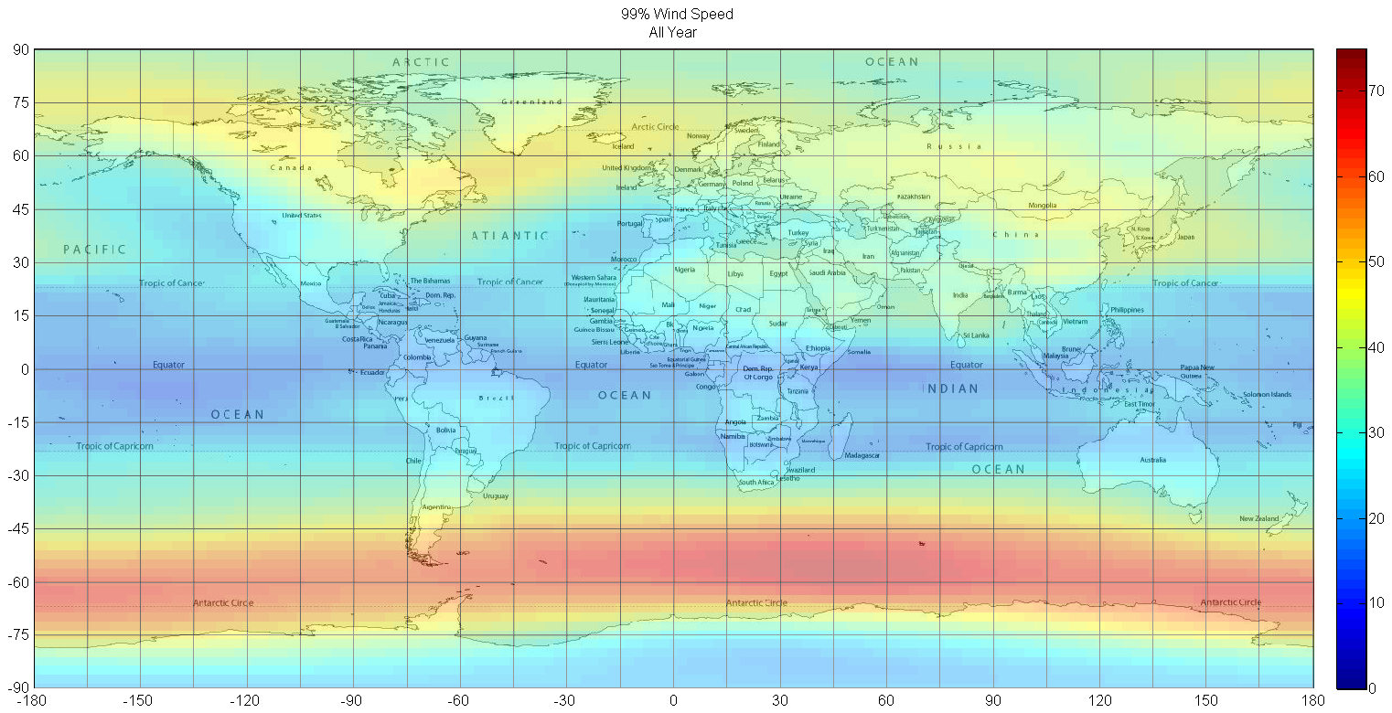
How slow can we fly? Must stay on station against winds!
Data Source: NOAA NCEP/NCAR Reanalysis 1
99th Percentile wind speeds (m/s) at 50 mbar pressure level (approximately 67,500 ft)

Slide 18
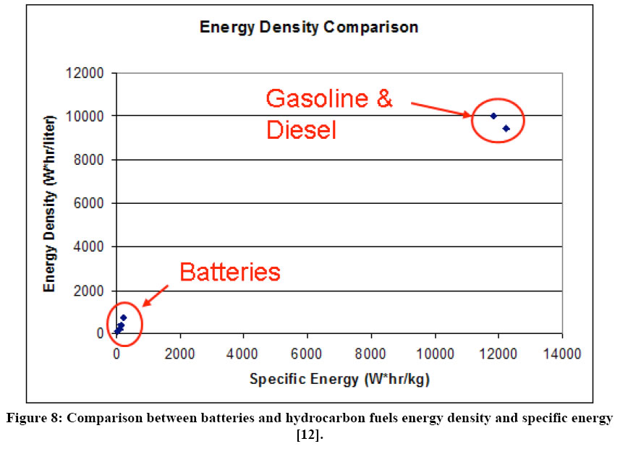
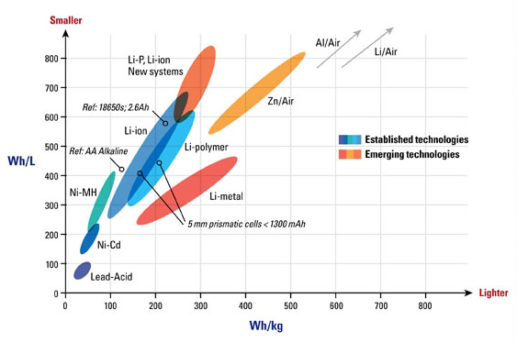
Energy Required: Night and Day
Two power system modes:
Daytime: Solar array power > required power
Array power → propulsion motors, avionics, & charge battery
Nighttime: All required power from onboard batteries
Required battery capacity = Power required * length of night
Sets required battery size & mass
Typical battery energy storage density ranges from 50 Wh/kg for lead-acid to 400 Wh/kg for emerging technology lithium battery types
Gasoline and diesel ~4,000 Wh/kg usable (12,000 Wh/kg X 33% η) >10x the best batteries available today!!
Battery energy storage has loss – energy recovered ~90-95% of energy input
Must account for battery packaging, typically 15-25% of cell mass

Slide 19
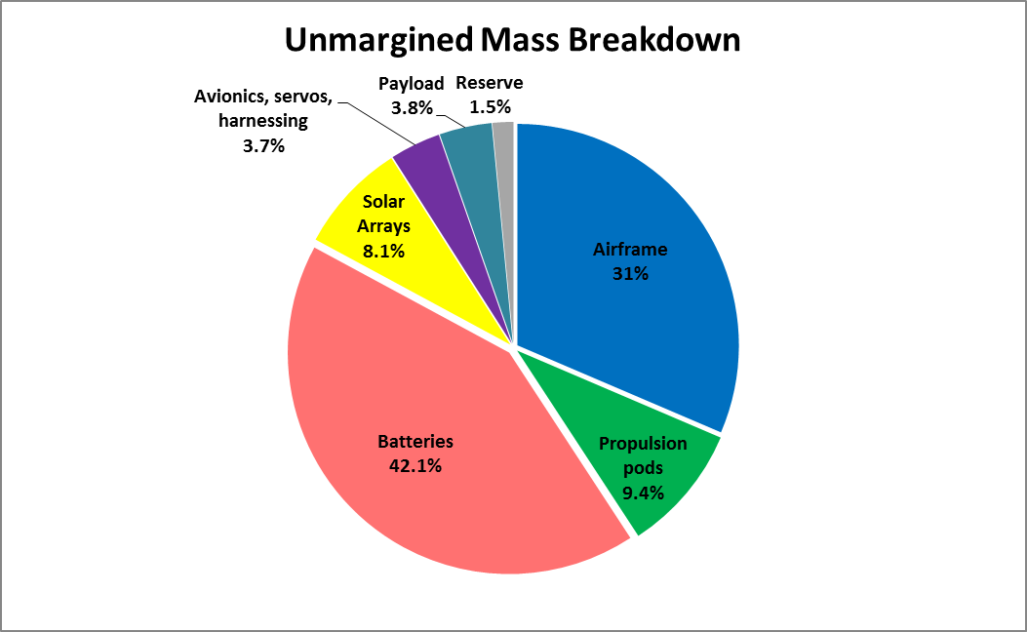
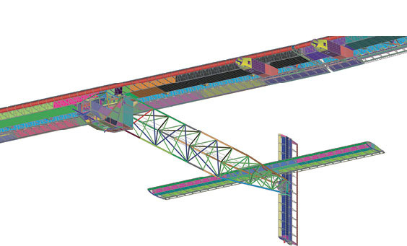
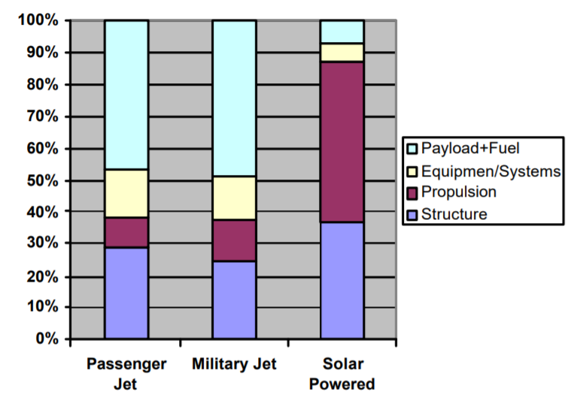
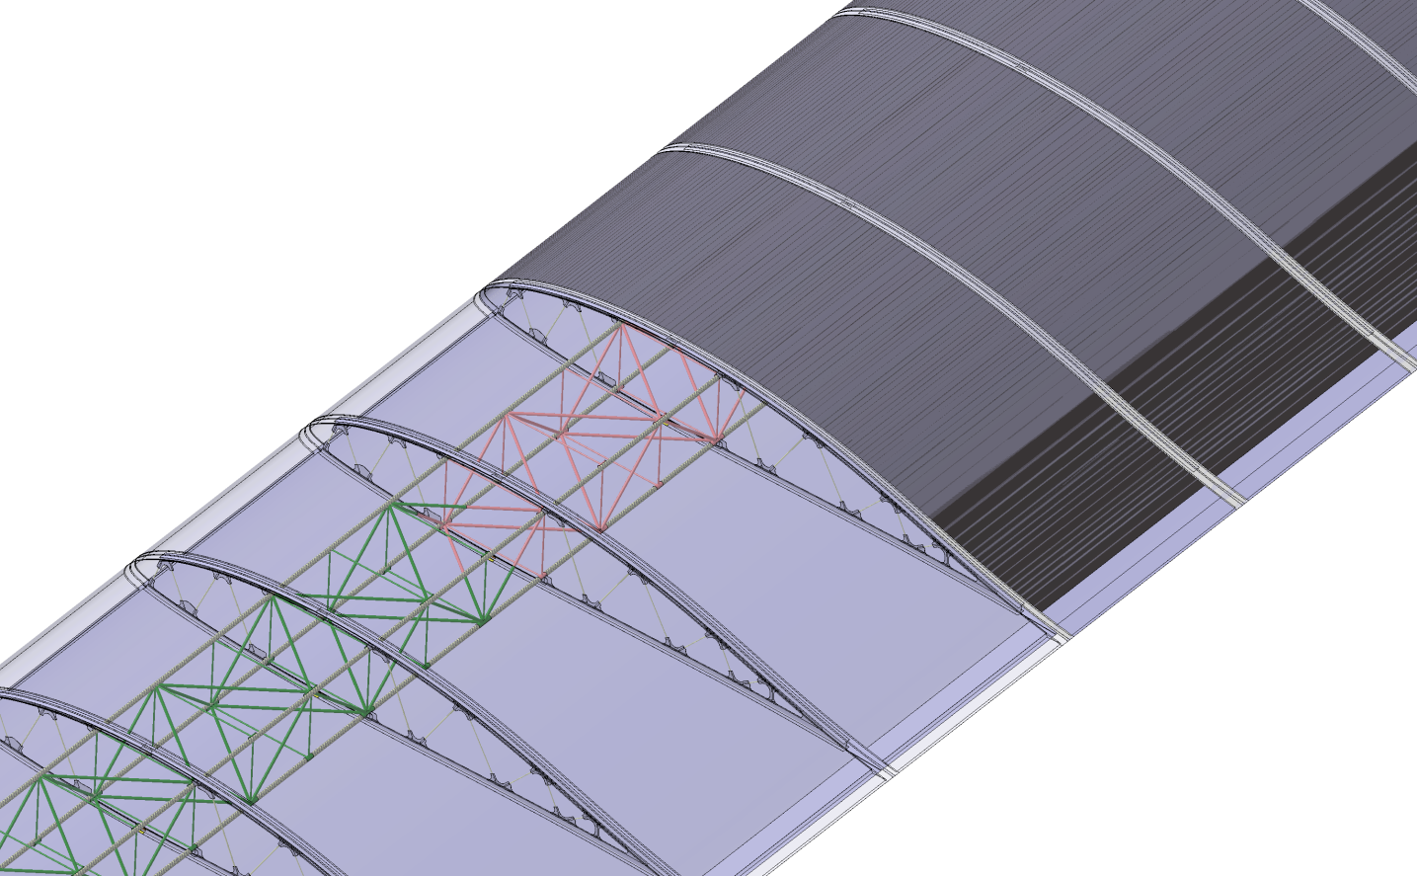
Mass
Everything must be lightweight!
Ultra-Lightweight Structures & Components!!
Odysseus baseline mass distribution
Aurora proprietary information – not for distribution
From Ref 1
Wing loading ~1 psf → very light structures & systems!
Energy storage accounts for 42% total mass in Odysseus. Location and distribution of this mass drives structure
3.8% payload fraction!

Slide 20
Energy Balance- Example
Climb-and-glide energy storage

Slide 21
Energy Cycle: Putting it together
Key mission parameters: Latitude and Day of Year
Sun angle & length of night both function of latitude and DOY
Drives energy available and energy storage requirement
Key Aircraft parameters: Weight, L/D, Flight speed
Drives energy needed
Latitude: 35 deg N, Altitude: 65,000 ft, Odysseus Baseline
Day | Hours of Night | E Collected (kWh) | E Storage Required (kWh)
Winter Solstice | 14.2 | 154 | 85
Equinox | 11.8 | 191 | 70
Summer Solstice | 9.5 | 227 | 57
50% more battery required to make it through winter night

Slide 22
Solar Airplane Optimization and Sizing Keys
Optimization Objective: Minimize size & cost of solar powered airplane for a given set of technology inputs; or determine technology required to achieve a given mission
Key Sizing Drivers:
Mission definition: latitude, time-of-year, min flight speed
Key technology and its parameters: power collection system, energy storage system, fixed mass components (avionics)
Sizing scaling: nearly everything scales!
Energy storage system: scales with energy stored
Structural sizing: scales with loads, mass (& its distribution), airspeed, aeroelastic effects
Power distribution and wiring: scale with power, length, efficiency
Electric motors: scale with torque, efficiency
Servo actuators: scale with control surface size, airspeed
Landing gear: scales with height, gross mass, speed
…

Slide 23
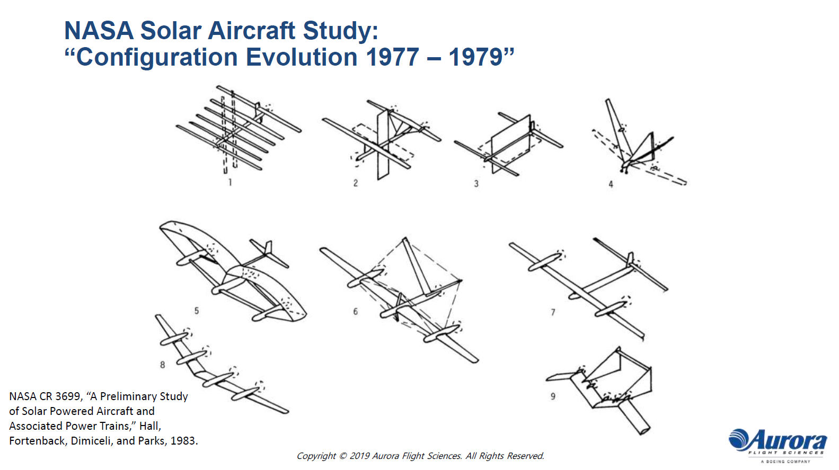

Slide 24
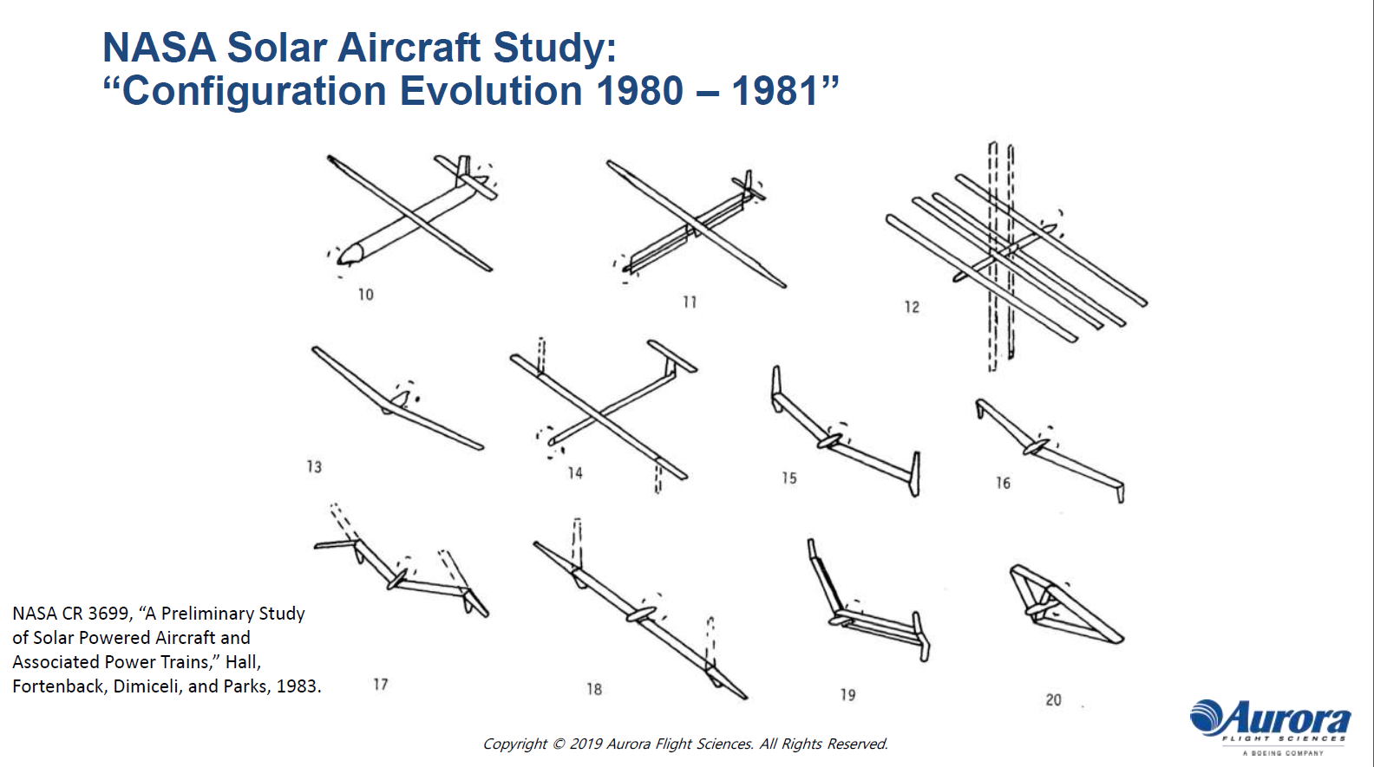

Slide 25
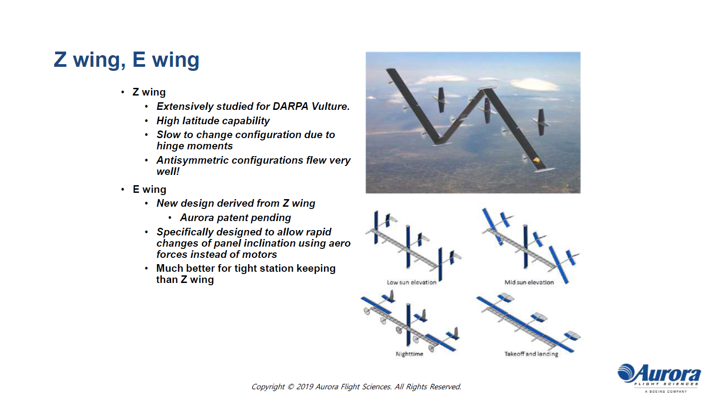

Slide 26
References
https://www.researchgate.net/publication/228843407_Fly_Around_the_World_with_a_Solar_Powered_Airplane
https://www.researchgate.net/publication/336455359_Review_of_Power_Device_for_Solar-Powered_Aircraft_Applications
https://engineering.fb.com/connectivity/open-sourcing-facebooks-solar-powered-aircraft-design-tools/
https://research.fb.com/publications/hale-multidisciplinary-design-optimization-part-i-solar-powered-single-and-multiple-boom-aircraft/
https://research.fb.com/publications/hale-multidisciplinary-design-optimization-part-ii-solar-powered-flying-wing-aircraft/
https://arc.aiaa.org/doi/10.2514/1.C034405

Slide 27
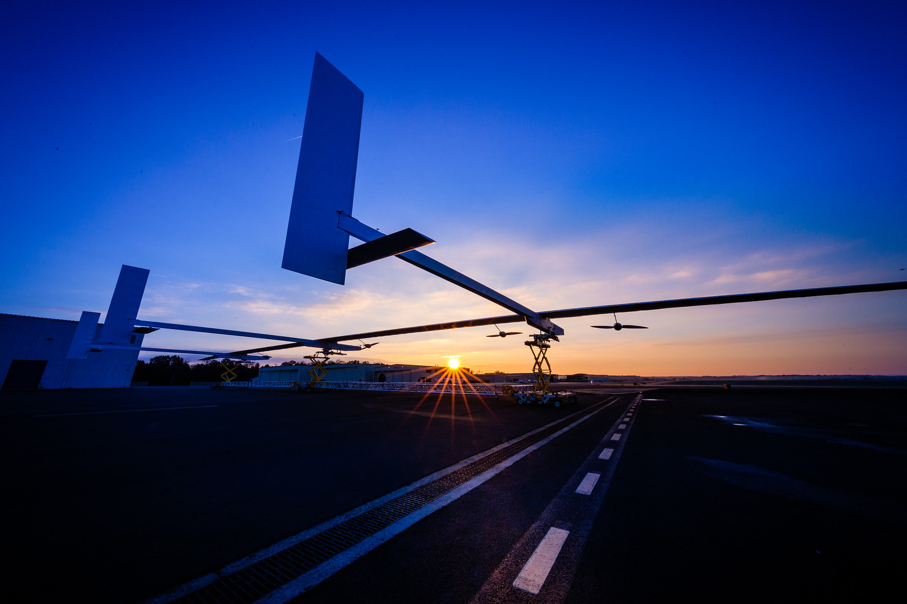

Thank you!
Questions?

